Slide 1

Operating systems
I/O Management, System Protection and Security
Venkatesh Prasad
Department of Computer Science

Slide 2
Operating systems
System Protection- Access Matrix
Venkatesh Prasad
Department of Computer Science

Slide 3
OPERATING SYSTEMS
Slides Credits for all PPTs of this course
The slides/diagrams in this course are an adaptation, combination, and enhancement of material from the following resources and persons:
Slides of Operating System Concepts, Abraham Silberschatz, Peter Baer Galvin, Greg Gagne - 9th edition 2013 and some slides from 10th edition 2018
Some conceptual text and diagram from Operating Systems - Internals and Design Principles, William Stallings, 9th edition 2018
Some presentation transcripts from A. Frank – P. Weisberg
Some conceptual text from Operating Systems: Three Easy Pieces, Remzi Arpaci-Dusseau, Andrea Arpaci Dusseau

Slide 4
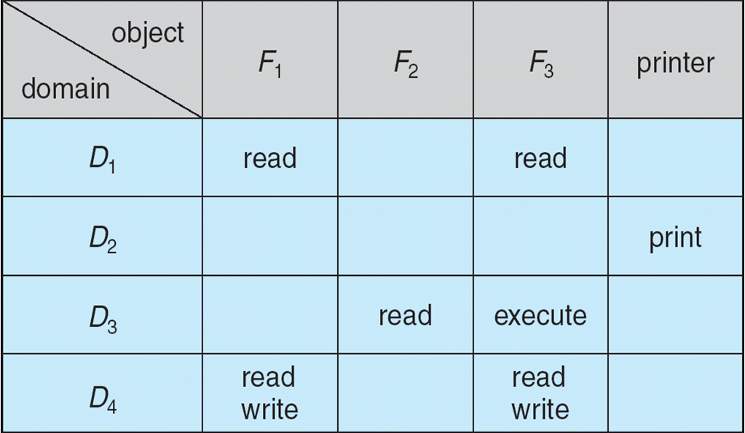
OPERATING SYSTEMS
Access Matrix
View protection abstractly as a matrix (access matrix)
Rows represent domains
Columns represent objects
Access(i, j) is the set of operations that a process executing in Domain_{i} can invoke on Object_{j}

Slide 5
OPERATING SYSTEMS
Use of Access Matrix
If a process in Domain D_{i} tries to do “op” on object O_{j}, then “op” must be in the access matrix
User who creates object can define access column for that object
Can be expanded to dynamic protection
Operations to add, delete access rights
Special access rights:
owner of O_{i}
copy op from O_{i} to O_{j} (denoted by “*”)
control – D_{i} can modify D_{j} access rights
transfer – switch from domain D_{i} to D_{j}
Copy and Owner applicable to an object
Control applicable to domain object

Slide 6
OPERATING SYSTEMS
Use of Access Matrix (Cont.)
Access matrix design separates mechanism from policy
Mechanism
Operating system provides access-matrix + rules
It ensures that the matrix is only manipulated by authorized agents and that rules are strictly enforced
Policy
User dictates policy
Who can access what object and in what mode
But doesn’t solve the general confinement problem i.e. preventing a process from taking disallowed actions
Ex: In a client/server situation, preventing a server from leaking information that the client considers confidential

Slide 7
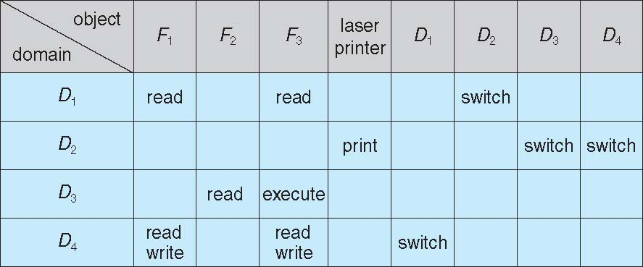
OPERATING SYSTEMS
Access Matrix with Domains as Objects
Processes should be able to switch from one domain to another.
Switching from domain Di to domain Dj is allowed if and only if the access right switch ∈ access(i, j).
Notes:
Switch is an operation
The entry access(i,j) defines the set of operations that a process executing in domain Di can invoke on object Oj
A process executing in domain D2 can switch to domain D3 or to domain D4. A process in domain D4 can switch to D1, and
one in domain D1 can switch to D2.

Slide 8
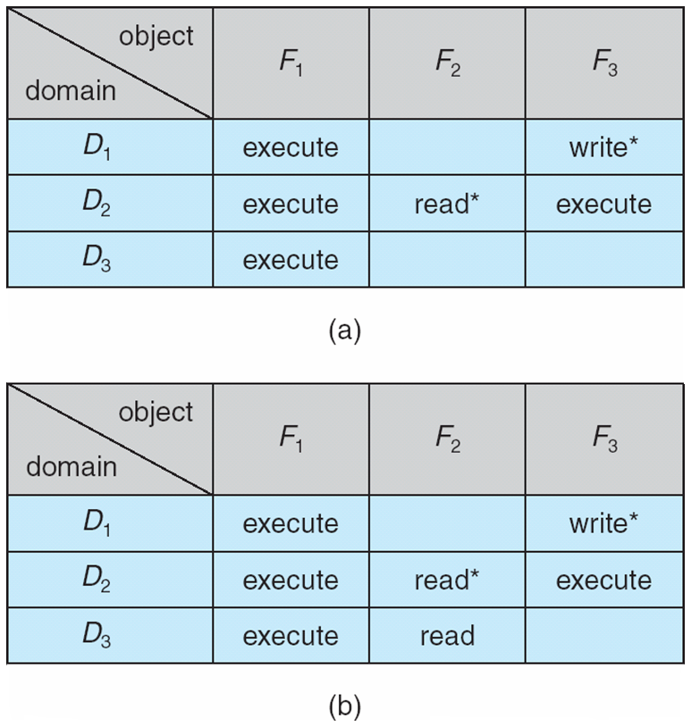
OPERATING SYSTEMS
Access Matrix with Copy Rights
The ability to copy an access right from one domain (or row) of the access matrix to another is denoted by an asterisk (*) appended to the access right.
Notes:
In Figure (a), a process executing in domain D2 can copy the read operation into any entry associated with file F2.
Hence, the access matrix of Figure (a) can be modified to the access matrix shown in Figure (b).
Propagation of the copy right may be limited. That is, when the right R∗ is copied from access(i, j) to access(k, j), only the right R (not R∗)
is created. A process executing in domain Dk cannot further copy the right R.

Slide 9
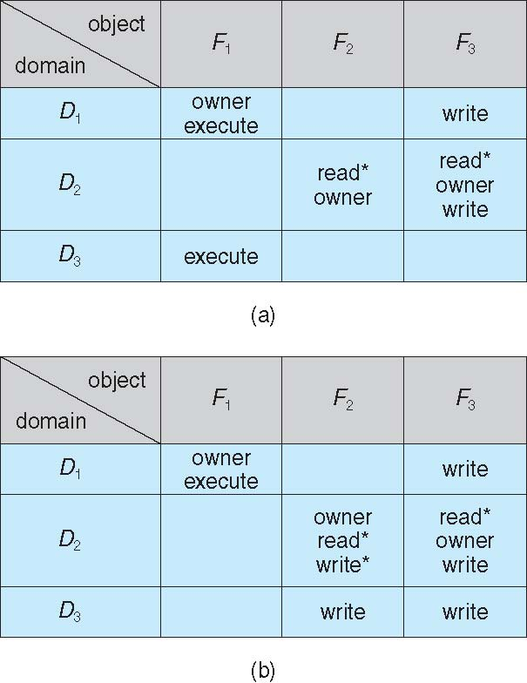
OPERATING SYSTEMS
Access Matrix with Owner Rights
Owner right controls addition of new rights and removal of some rights.
Domain D1 is the owner of F1 and can add /delete any valid right in column F1
Owner rights allow a process to change the entries in a column

Slide 10
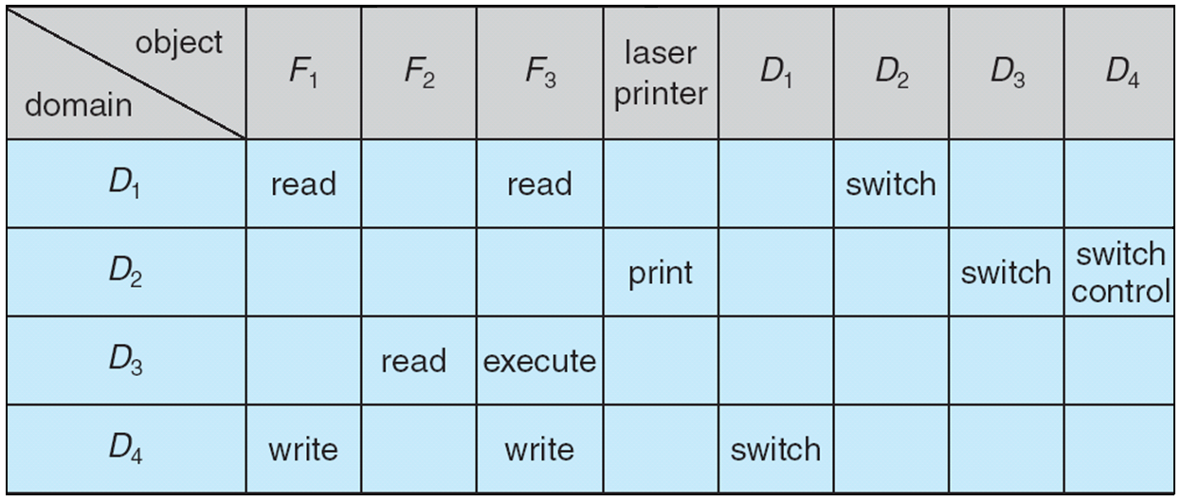
OPERATING SYSTEMS
Modified Access Matrix with Domains as Objects
Control right is applicable only to domain objects
Process executing in domain D2 could modify domain D4 (i.e. D2 can remove any access right from row 4)

Slide 11

THANK YOU
Venkatesh Prasad
Department of Computer Science Engineering
venkateshprasad@pes.edu

